Slide 1



Automated Web Crawling and Analytics of Job Listings for Skill Demand and Trend Analysis
Team -8
JYOSTNA SREE SOMISETTY
TEJASWINI GADERABOINA
MAHESH BURRA

Slide 2
PROBLEM STATEMENT
Job seekers often lack structured insights into remote job trends and hiring patterns.RemoteOK.io lists valuable job data, but it is unstructured and not ready for analysis.This creates a need for automated tools to extract, organize, and analyze job listings effectively.

Slide 3
OUR APPROACH
1. Web Crawling: Python + BeautifulSoup to extract job data from multiple pages.
2. Database Storage: Direct insertion into SQLite (no CSV intermediates).
3. Analysis: Cleaned data analyzed using Pandas, statsmodels, and TextBlob.
4. Insights: Delivered through descriptive stats, regression, and sentiment analysis.

Slide 4
QualitativeData Source & Fields
Database Design & Implementation
Website:https://remoteok.io/remote-dev-jobs Fields
Scraped: Title, Company, Tags, Date Posted, Source, Location ('Remote') Records
Collected: 1000+ jobs
Tools Used: requests, BeautifulSoup, sqlite3, pandas
DB: SQLite – fast, lightweight, SQL-compatible
Schema: id, source, title, company, location, tags, date_posted
Insertion: Real-time from scraper to database
Why: Avoids loss from CSV parsing; supports immediate SQL queries

Slide 5
01
Data Cleaning
Removed entries with missing title, company, or tags.
Normalized text and cleaned tag formats.
Removed duplicates by title, company, and date.
DATA CLEANING & FEATURE ENGINEERING
02
Feature Engineering
title_length: Used to predict seniority.
is_senior: Binary flag based on title.
sentiment_score & label: Polarity from tags using TextBlob.
tag_count: Number of tags per listing.
posting_day: Extracted weekday from date.

Slide 6


TECHNICAL IMPLEMENTATION
The project involved three core technical components:
a. Web Crawling :
Developed a Python-based crawler using libraries such as requests, BeautifulSoup, or Selenium.
Ensured all data was inserted directly into a database without intermediate files.
b. Database Setup :
Used SQLite3 for simplicity and portability.
Designed a jobs table to store all relevant fields:
SQL code :
id INTEGER PRIMARY KEY,
title TEXT, company TEXT, location TEXT, tags TEXT, date_posted TEXT
c. Analytics in Python :
All analyses were performed in Jupyter Notebook using : pandas for data manipulation , matplotlib for visualization , TextBlob for sentiment analysis , statsmodels for regression modeling.

Slide 7
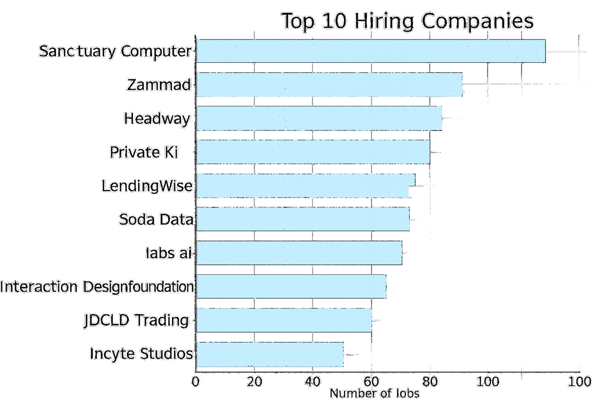

TOP HIRING COMPANIES
This chart showcases the top 10 companies with the highest number of remote job postings on RemoteOK.io, reflecting strong hiring activity in sectors like SaaS, fintech, and developer tooling. These companies consistently seek remote tech talent, making them valuable targets for job seekers aiming to align with high-demand employers in the remote job market.

Slide 8
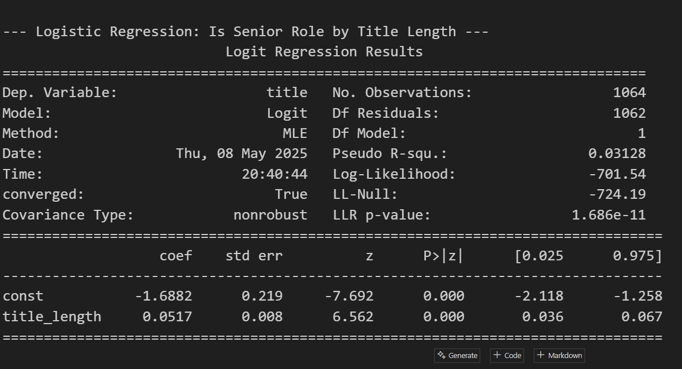
LOGISTIC REGRESSION – SENIOR ROLE PREDICTION
LOGISTIC REGRESSION WAS USED TO PREDICT IF A JOB IS “SENIOR” BASED ON TITLE LENGTH.
FOR EACH ADDITIONAL CHARACTER IN THE JOB TITLE, THE LIKELIHOOD OF IT BEING A SENIOR ROLE INCREASES.
COEFFICIENT FOR TITLE_LENGTH = 0.0517
RESULT IS STATISTICALLY SIGNIFICANT (P-VALUE < 0.001)
LONGER TITLES ARE STRONGLY ASSOCIATED WITH SENIOR-LEVEL ROLES.
THE MODEL SHOWS A MODEST BUT MEANINGFUL FIT (PSEUDO R² = 0.031)

Slide 9
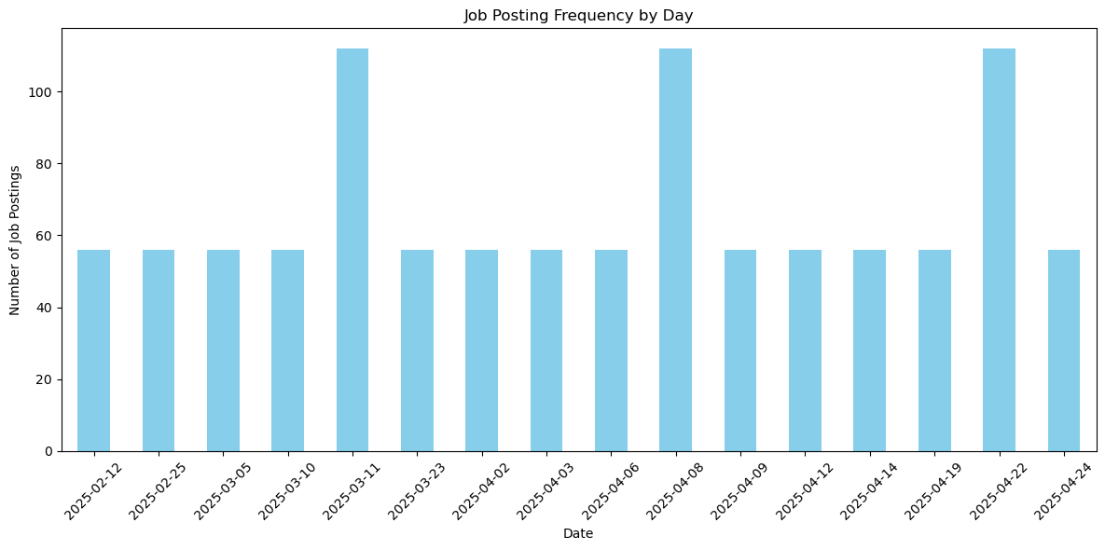
JOB POSTING FREQUENCY BY DAY
This chart tracks the daily volume of job postings over time. Peaks indicate days with major hiring activity, helping identify potential recruitment cycles or campaign launches.

Slide 10
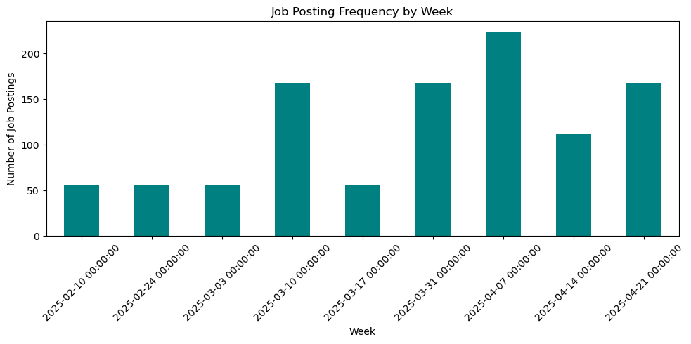
JOB POSTING FREQUENCY BY WEEK
AGGREGATED WEEKLY DATA SHOWS BROADER HIRING TRENDS. WEEKS WITH HIGHER BARS MAY CORRESPOND TO RECRUITMENT DRIVES OR END-OF-QUARTER HIRING BURSTS.

Slide 11
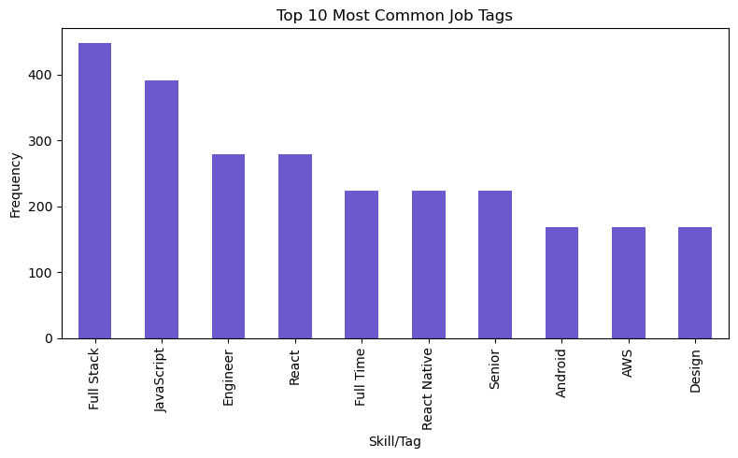
TOP 10 MOST COMMON JOB TAGS
THIS BAR CHART HIGHLIGHTS THE MOST FREQUENTLY USED SKILLS OR ROLES ACROSS JOB POSTINGS. “FULL STACK,” “JAVASCRIPT,” AND “ENGINEER” DOMINATE, REFLECTING HIGH DEMAND FOR GENERALIST AND FRONTEND DEVELOPMENT SKILLS.

Slide 12
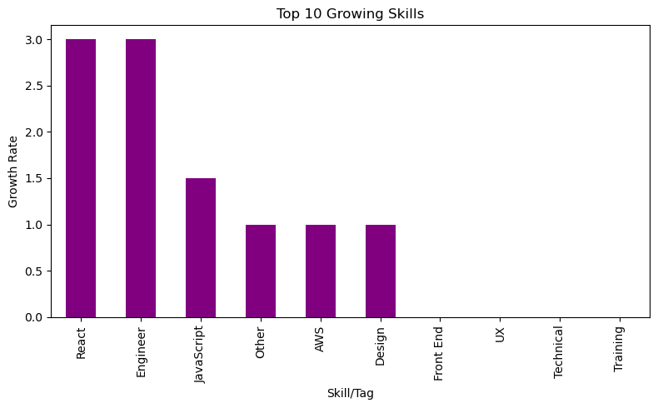
TOP 10 GROWING SKILLS
SKILLS LIKE “REACT,” “ENGINEER,” AND “JAVASCRIPT” SHOW A RAPID INCREASE IN DEMAND, INDICATING EMERGING TECH STACKS OR PROJECT SHIFTS IN HIRING PREFERENCES.

Slide 13
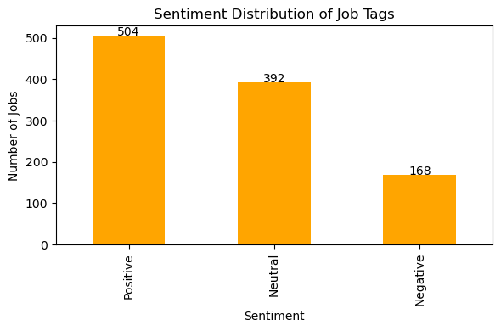
SENTIMENT DISTRIBUTION OF JOB TAGS
THIS CHART SHOWS THE EMOTIONAL TONE OF JOB DESCRIPTIONS. A MAJORITY ARE POSITIVE, SUGGESTING COMPANIES ARE POSITIONING ROLES OPTIMISTICALLY TO ATTRACT APPLICANTS.

Slide 14
HOW OUR ANALYSIS IS USEFUL
FOR JOB SEEKERS:
IDENTIFY COMPANIES THAT ARE ACTIVELY AND CONSISTENTLY HIRING FOR REMOTE ROLES.
DISCOVER WHICH TECHNOLOGIES AND SKILLS ARE MOST IN-DEMAND ACROSS LISTINGS.
ASSESS SENIORITY BY ANALYZING JOB TITLE PATTERNS AND WORDING.
FOR EDUCATORS & TRAINERS:
ALIGN COURSE CONTENT AND LEARNING OUTCOMES WITH REAL-WORLD JOB MARKET NEEDS.
UPDATE AND DESIGN TRAINING PROGRAMS AROUND TRENDING TOOLS AND TECHNOLOGIES.
USE REAL JOB DATA TO CREATE CASE STUDIES AND CURRICULUM MODULES.
FOR DATA ANALYSTS & RESEARCHERS:
SHOWCASES AN END-TO-END ANALYTICS PIPELINE USING OPEN-SOURCE TOOLS.
DEMONSTRATES HOW UNSTRUCTURED WEB DATA CAN BE TRANSFORMED INTO MEANINGFUL INSIGHTS.
PROVIDES A REUSABLE FRAMEWORK FOR ANALYZING OTHER PLATFORMS OR INDUSTRIES.

Slide 15
THANK YOU

